Slide 1


Topology and Resilience: A Geospatial Analysis of Transportation Network In North Carolina
Trung V. Tran, PhD, GISP
Associate Professor of Geospatial Science
NCMUG / NCAMPO 2025, Wilmington, North Carolina

Slide 2
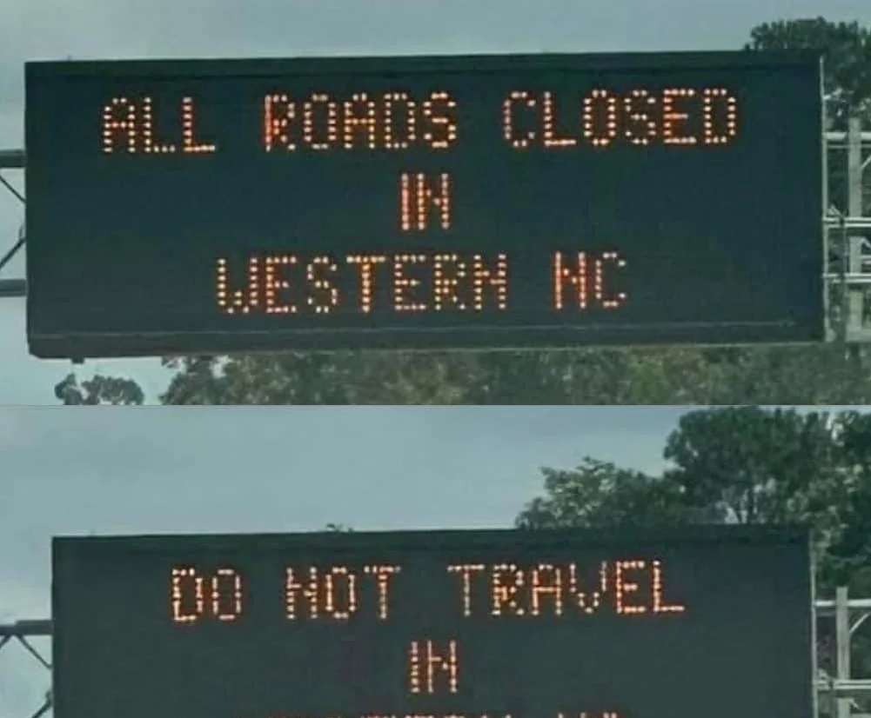
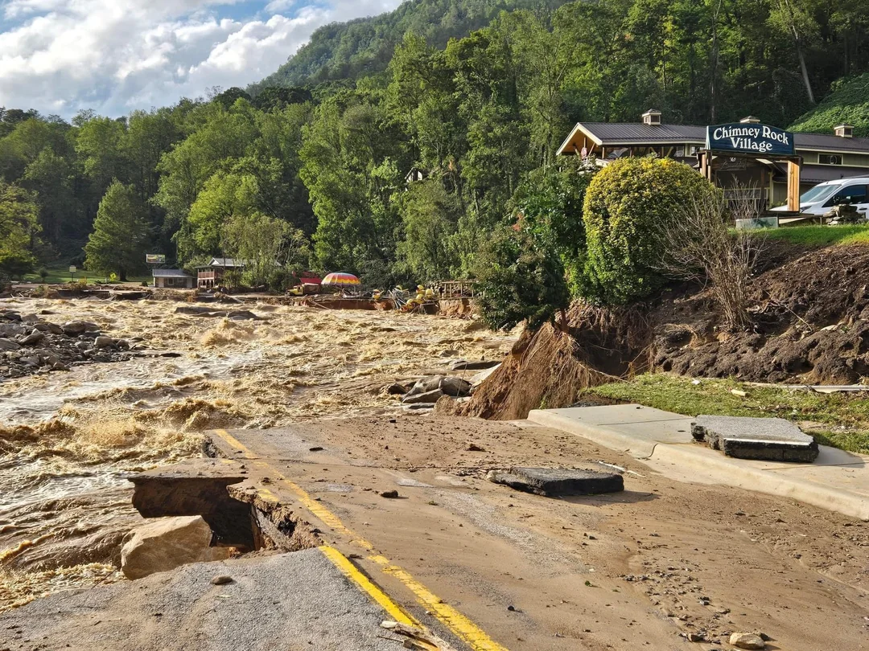
Introduction [1/3]
Climate change causes more frequent and extreme disasters, such as hurricane, heavy rainfall, and floods, leading to stress on transportation infrastructure (roads, bridges) ^{[1,2]}.
Role of transportation in society.
  Transportation plays critical role in achieving Sustainable Development Goals proposed by the UN ^{[3]}.
  Transportation is crucial in enhancing economic growth, and improving accessibility, as well as enhancing resilience of cities, urban-rural linkages, and productivity of rural areas ^{[3]}.
  Transportation has great impact on socio-economic development, environmental sustainability, human health, and public safety, especially in urbans as they are increasingly becoming socio-economic and demographic resulting from the steady increasing of population and urbanization ^{[1,2,4]}.
Importance of transportation resilience
  Resilience of transportation system affects the resilience of other critical systems ^{[2]}.
  Resilient transportation allows people, goods, repair, relief, and disaster response teams to act effectively as well as provides accessibility to essential services while others are being restored after a disaster ^{[2]}.
Resilience refers to not only to the ability of transportation infrastructure to resist natural disasters, such as heavy rainfall, but also the ability to quickly return to normal operations after a disaster.
Courtesy: Blue Ridge Parkway
Lang et al. 2024. Resilience Assessment and Enhancement Strategies for Urban Transportation Infrastructure to Cope with Extreme Rainfalls. Sustainability, 16(11), 4780.
Serdar et al. 2022. Urban transportation networks resilience: indicators, disturbances, and assessment methods. Sustainable Cities and Society, 76, p.103452.
United Nations. n.d. Sustainable Transportation. Sustain Development Goals Knowledge Platform. https://sustainabledevelopment.un.org/topics/sustainabletransport
Kapucu et al. 2023. Building urban infrastructure resilience through network governance. Urban Governance, 3(1), pp.5-13.

Slide 3
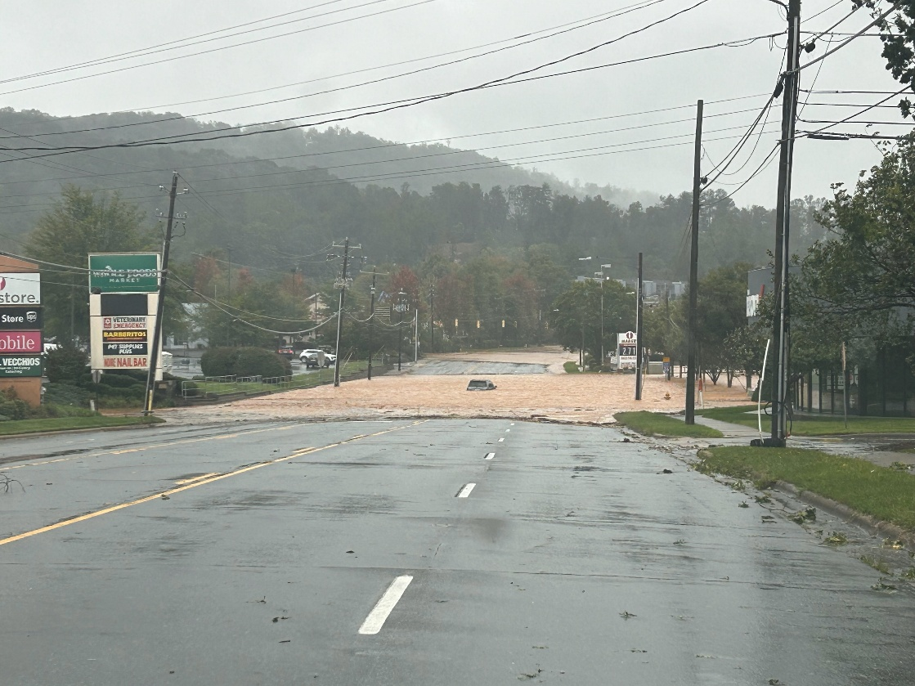

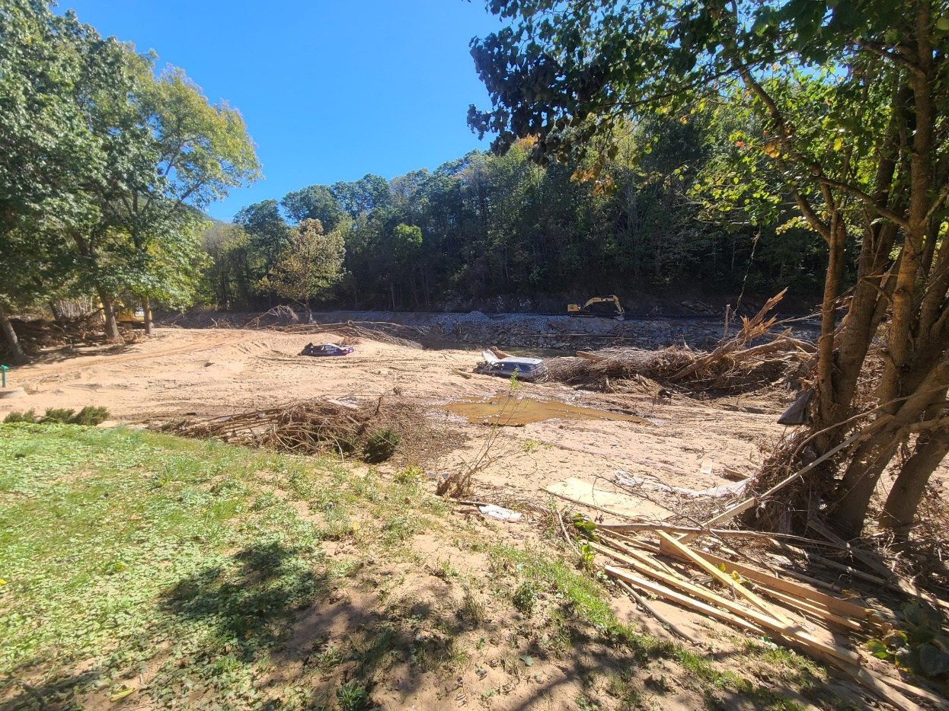
Asheville – The Aftermath
Courtesy: Kristine
Courtesy: Chris Parris
Courtesy: Chris Parris

Slide 4
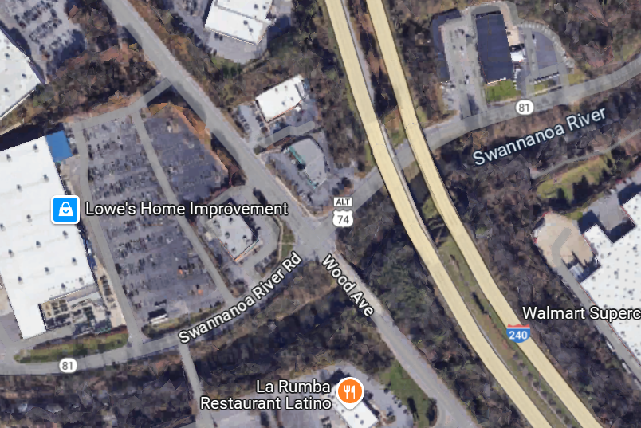
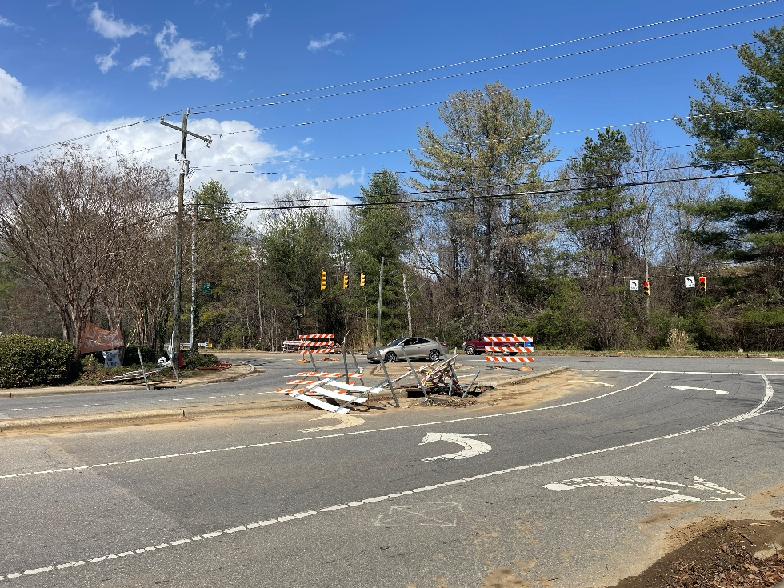
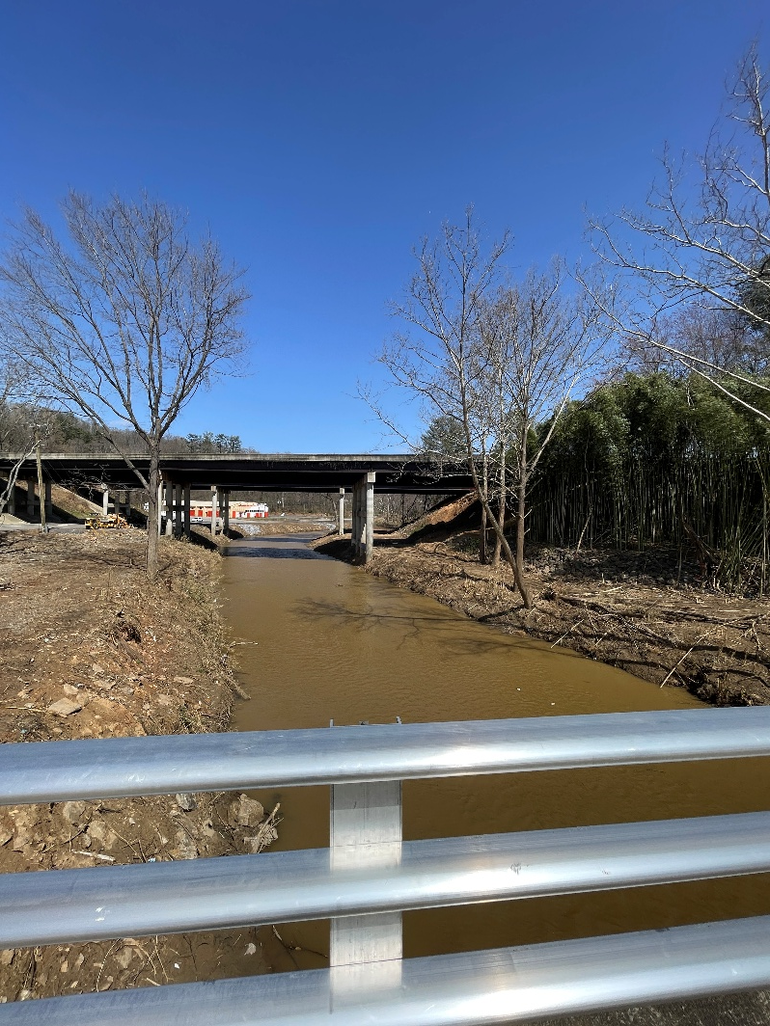
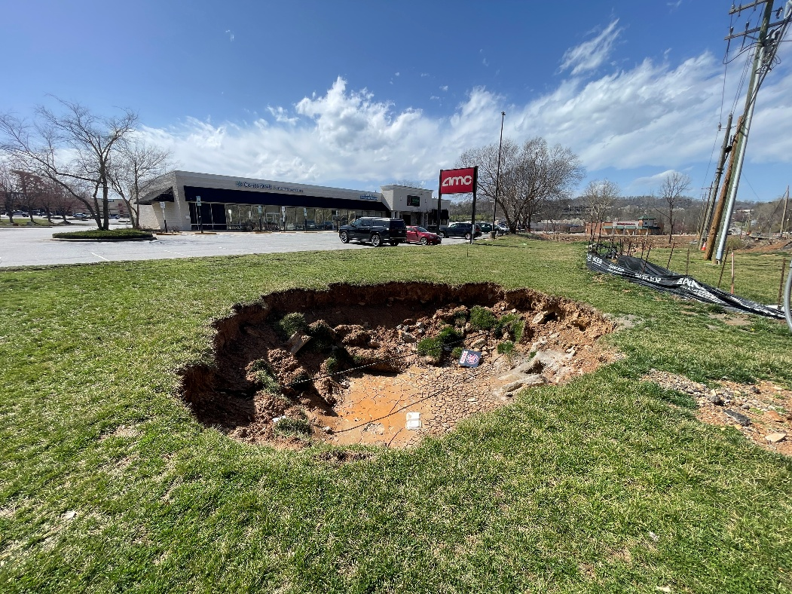
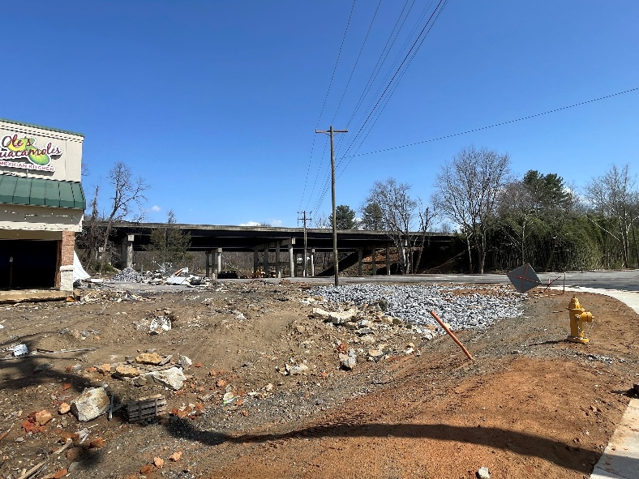
Asheville – The Aftermath

Slide 5
Introduction [2/3]
Assessing and improving transportation resiliency is crucial.
  To ensure the stability of urban transportation operations
  To enhance the overall resilience of cities to extreme events
Assessment approaches ^{[2]}
  Performance-based (service level, capacity, travel time): Reflect performance over time in different stages
  Centrality (connectivity) metrics: Simple, suitable for large scale networks
  Cost: Relatable by decision-makers and can expand to consider direct or indirect damage and recovery plans
  Statistical indicators: Detect abnormality, suitable for real-time monitoring and assessment in smart cities
  Qualitative indicators: Less reliable, based on experience or expert opinion
Notes:
Performance-based (service level, capacity, travel time): Reflect performance over time in different stages
Centrality (connectivity) metrics: Simple, suitable for large scale networks
Cost: Relatable by decision-makers and can expand to consider direct or indirect damage and recovery plans
Statistical indicators: Detect abnormality, suitable for real-time monitoring and assessment in smart cities
Qualitative indicators: Less reliable, based on experience or expert opinion

Slide 6
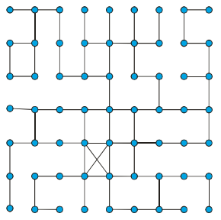
Introduction [3/3]
Network Topology
  Network topology defines the structure and arrangement of nodes (intersections) and edges (connections) in a system.
  Characterized by connectivity and accessibility measures
Assessing Transportation Network Resiliency via Network Topology
  Measuring connectivity via indices (e.g. average number of edges on nodes)
  Measuring accessibility via indices (e.g. maximum distance among all shortest distances between O-D pairs)
Importance of Network Topology toward Resiliency
  A collapse of a node or an edge may cause disruptions of the entire network.
  Removal of nodes with high degree of connectivity might turn a network system into vulnerability.

Slide 7
Research Goal and Objectives
Goal:
  To assess the resilience of road networks under random events, such as natural hazards.
Objectives
  To quantify changes in service area coverage of essential services due to random disruptions in the transportation network.
  To compare and contrast service area coverage in four NC cities (Asheville, Charlotte, Durham, Greensboro, and Raleigh) to determine network vulnerability.
  To identify how the geographic distribution of essential services impacts accessibility under disruptions.
Research Questions
  How does the service area coverage of essential services change as network disruptions increase?
  Which of the five NC cities demonstrates the highest vulnerability to network disruptions?
  How does the spatial distribution of essential services might affect their accessibility when random barriers are introduced?

Slide 8
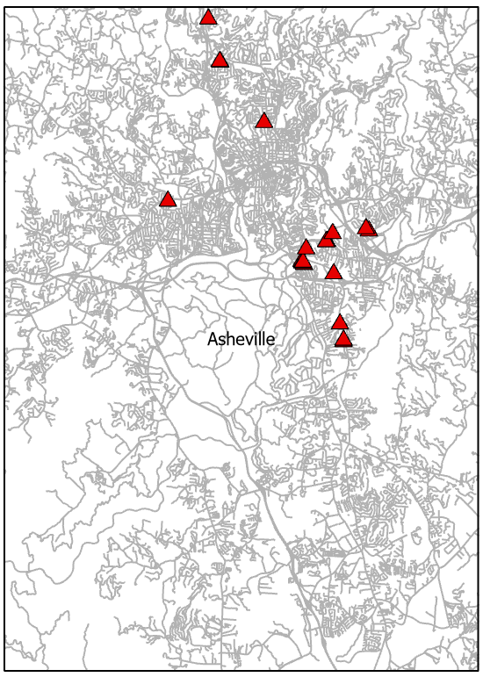
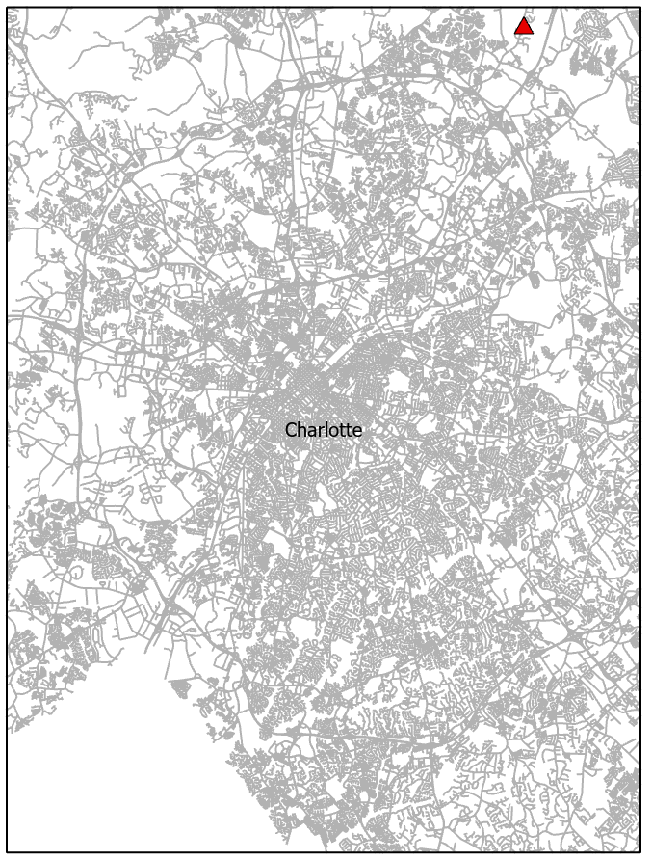
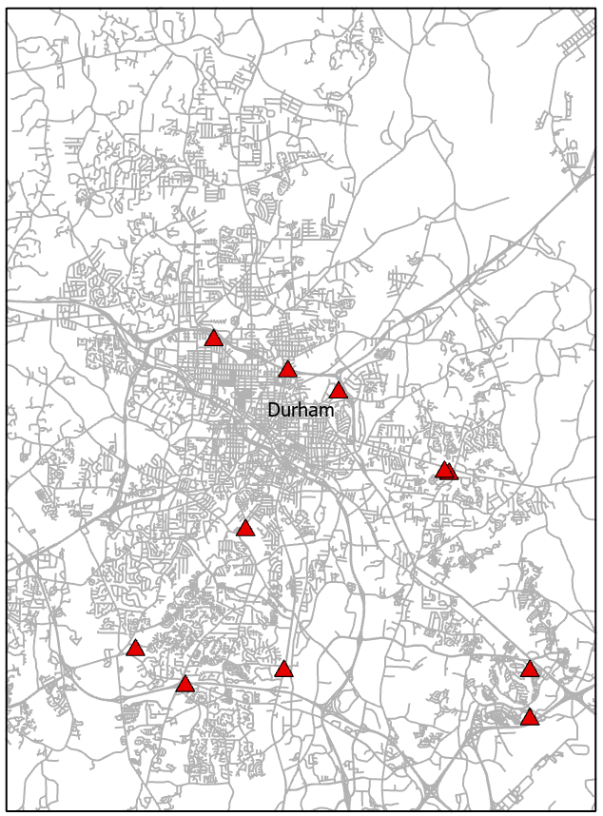
Study Areas
Asheville
Envelop Area: 195 sqmi
Total road length: 1,702 miles
Total junctions: 10,848
Total buildings: 64,030
Essential-purpose buildings: 19
Charlotte
Envelop Area: 544 sqmi
Total road length: 5,104 miles
Total junctions: 39,700
Total buildings: 315,177
Essential-purpose buildings: 1
Durham
Envelop Area: 257 sqmi
Total road length: 1,927 miles
Total junctions: 13,369
Total buildings: 104,032
Essential-purpose buildings: 11

Slide 9
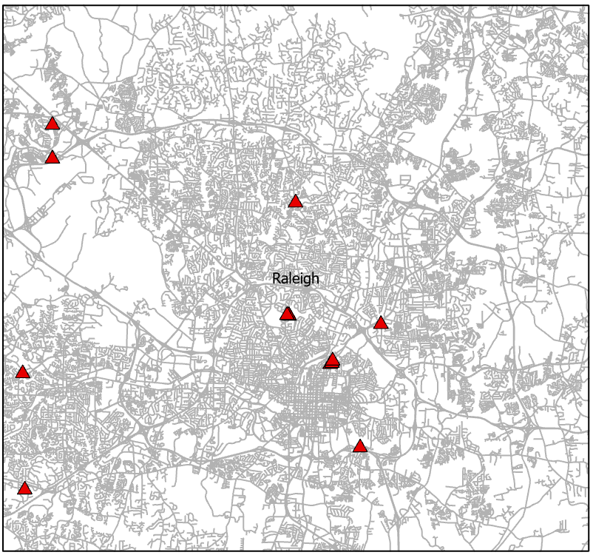
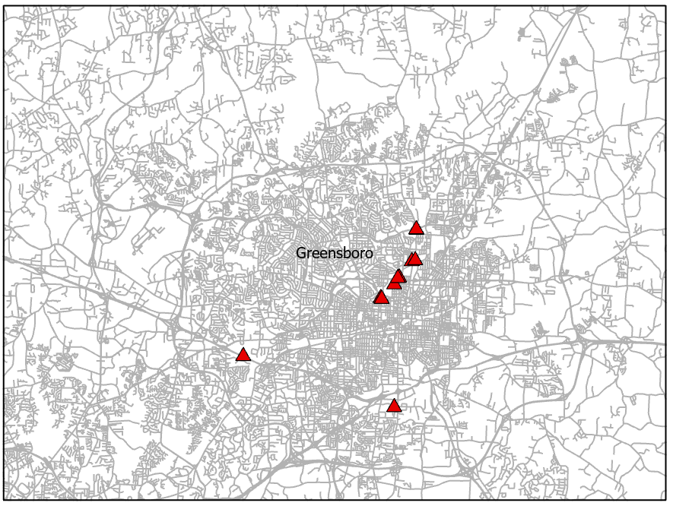
Study Areas
Greensboro
Envelop Area: 337 sqmi
Total road length: 2,772 miles
Total junctions: 18,117
Total buildings: 163,295
Essential-purpose buildings: 11
Raleigh
Envelop Area: 354 sqmi
Total road length: 2,772 miles
Total junctions: 18,117
Total buildings: 163,295
Essential-purpose buildings: 11

Slide 10
Data
NCDOT Roads Geodatabase
  Networks were built for each cities.
    Driving directions were accounted.
    Travel time were accounted.
North Carolina Building Footprint
  FEMA Hazus Program’s Building Inventory Data
  Buildings for essential purposes were selected as service providers for Service Area analyses.

Slide 11
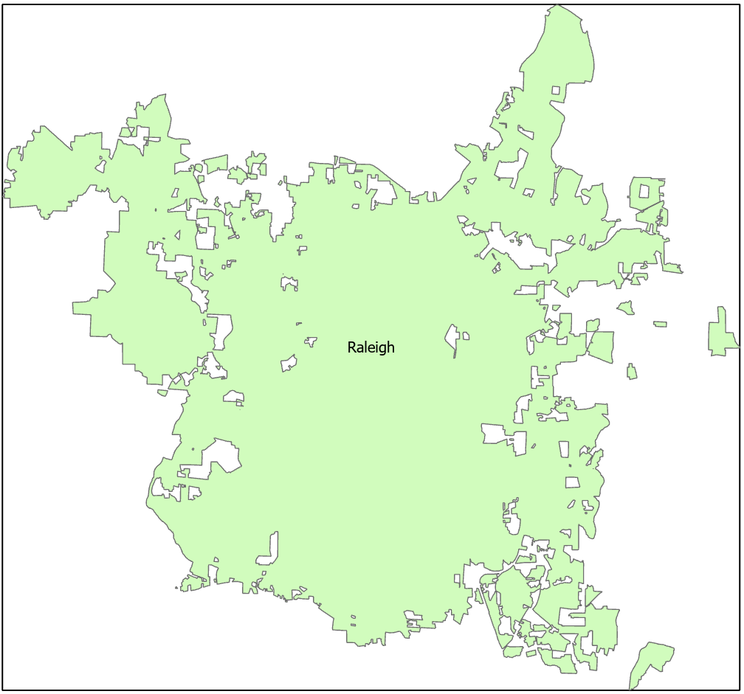
Methodology [1/2]
Preprocessing
  Generate geographic envelops of cities based on census places.
  Clip NC Roads to envelops.
  Calculate lengths and travel times of road segments.
  Build network datasets (impedance = travel time/minutes)
  Extract NC Building Footprints, essential places and residential places, to envelops.
  Generate random network barrier points
    Network barriers as edge centroids were randomly selected for 6 scenarios: 5% of the total edges, 10%, 15%, 20%, 25%, and 30%.
Raleigh and its envelop
Map scale: 1:220,000

Slide 12
Methodology [2/2]
Network Analysis/Service Area Analysis: to quantify service area coverages of essential places with and without random network barriers.
  Conduct Service Area Analyses at 5, 10, 15 minutes cutoffs for each city.
    For each cutoff, Service Area Analyses were conducted under non-barrier and with-barrier scenarios.
    Service coverages (in square mile) were recorded for post-analyses.
Geographic Distribution / Standard Distance (1SD): to quantify the degree of compactness of essential places within cities.

Slide 13
Findings

Slide 14
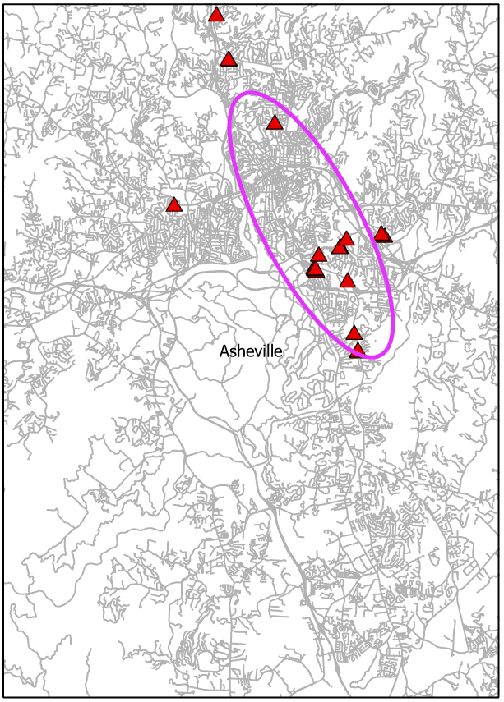
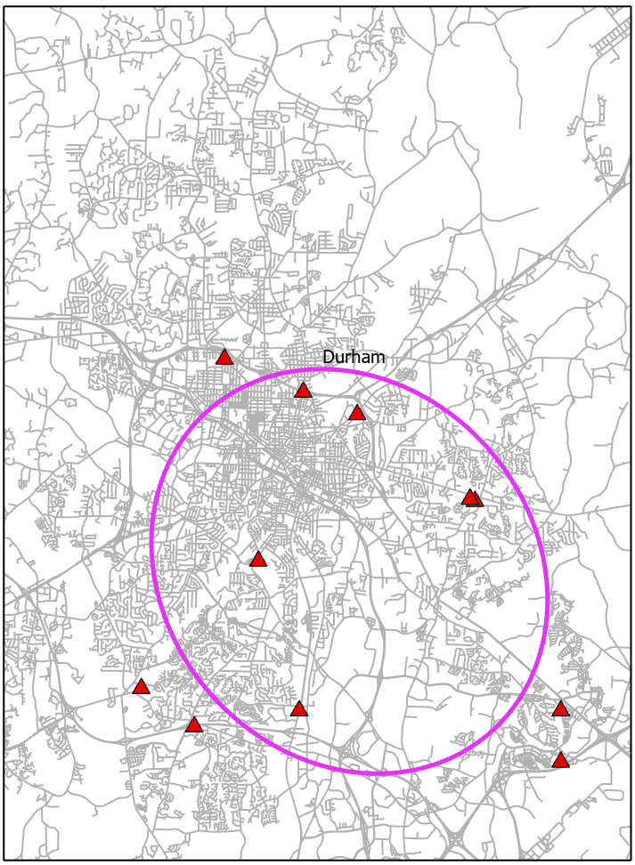
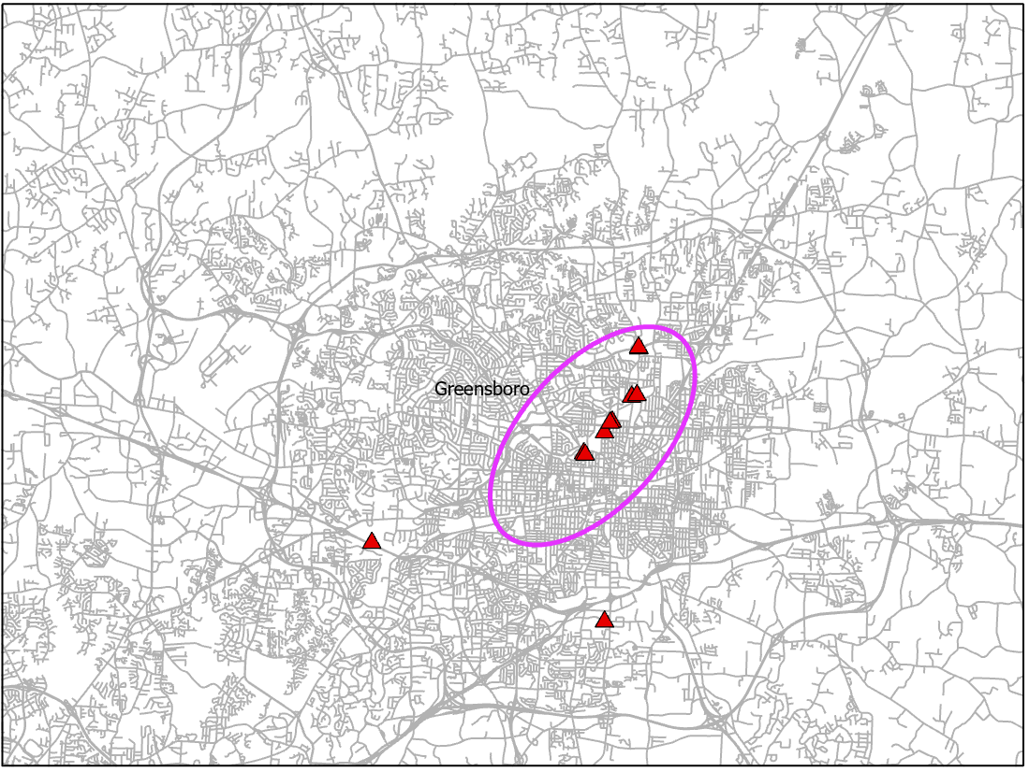
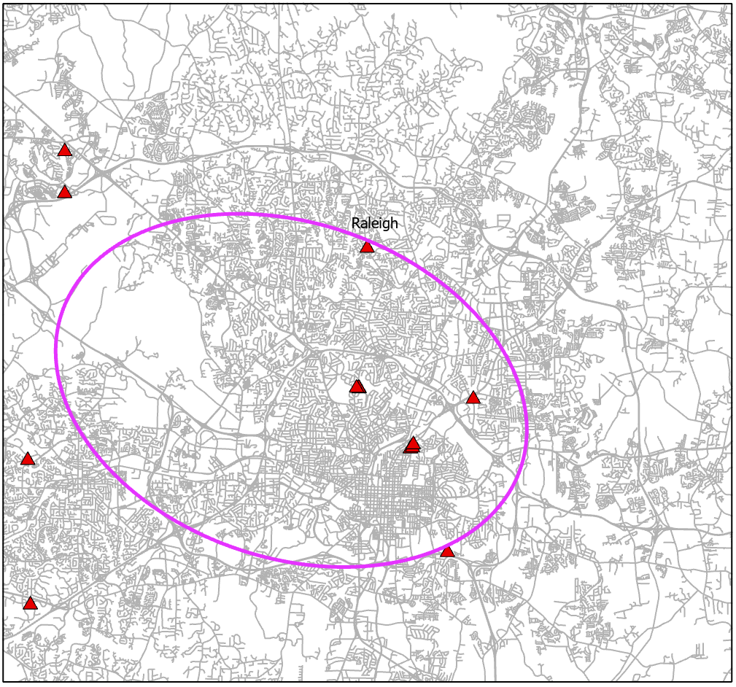
Spatial Distributions of Essential Places
Asheville
Elongated
Long axis: 6,973
Short axis: 2,322
Ratio: 3
Durham
Dispersed
Long axis: 9,330
Short axis: 8,073
Ratio: 1.1
Greensboro
Slightly Elongated
Long axis: 5,465
Short axis: 2,938
Ratio: 1.9
Raleigh
Dispersed
Long axis: 12,884
Short axis: 8,909
Ratio: 1.4

Slide 15
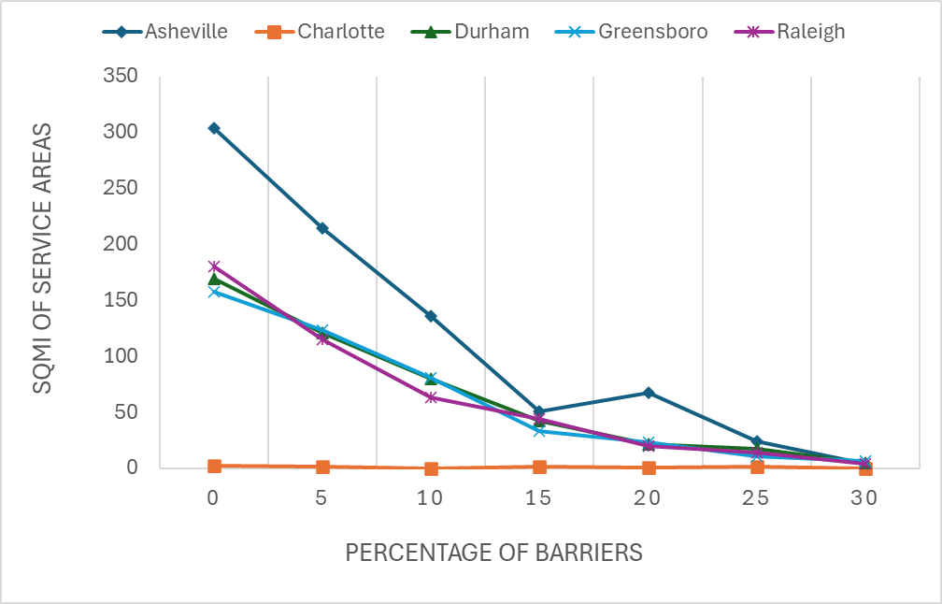
Effect of Random Barriers on Service Area Coverage at 5 Minute Cutoff
Asheville: Experiences the Steepest Decline in Service Area Coverage (98.55% decrease)
  Initial Coverage (0% Barriers): 303.81 sq. mi.
  Final Coverage (30% Barriers): 4.40 sq. mi.
Durham, Greensboro, Raleigh: Show Moderate but Steady Declines in Coverage
  Durham: 169.73 sq. mi. (0%) → 5.07 sq. mi. (30%) (a 97% reduction).
  Greensboro: 158.17 sq. mi. (0%) → 6.57 sq. mi. (30%) (95.8% reduction).
  Raleigh: 180.07 sq. mi (0%) to 4.38 sq. mi (30%) (97.6% reduction)
0-15% Barriers:
Asheville: -83%
Durham: -75%
Greensboro: -79%
Raleigh: -76%
-29%
-37%
-22%
-62%
-34%
+33%
-63%
-58%
-82%

Slide 16
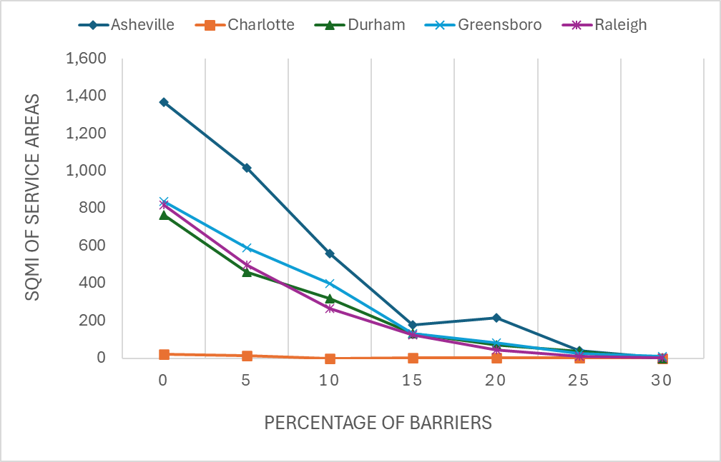
Effect of Random Barriers on Service Area Coverage at 10 Minute Cutoff
0-15% Barriers:
Asheville: -87%
Durham: -83%
Greensboro: -84%
Raleigh: -85%
-25%
-45%
-29%
-68%
-32%
-66%

Slide 17
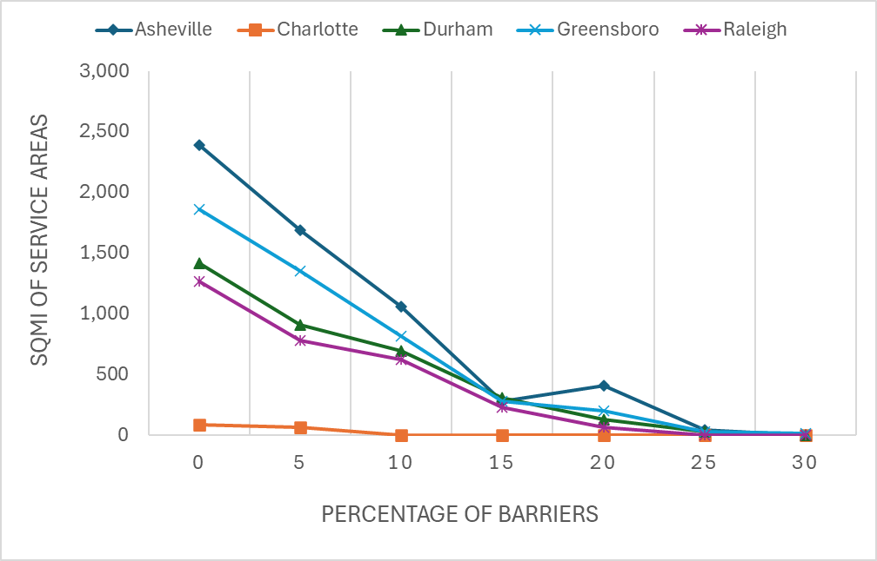
Effect of Random Barriers on Service Area Coverage at 15 Minute Cutoff
0-15% Barriers:
Asheville: -88%
Durham: -78%
Greensboro: -85%
Raleigh: -82%
-29%
-37%
-27%
-73%
-40%
-66%

Slide 18
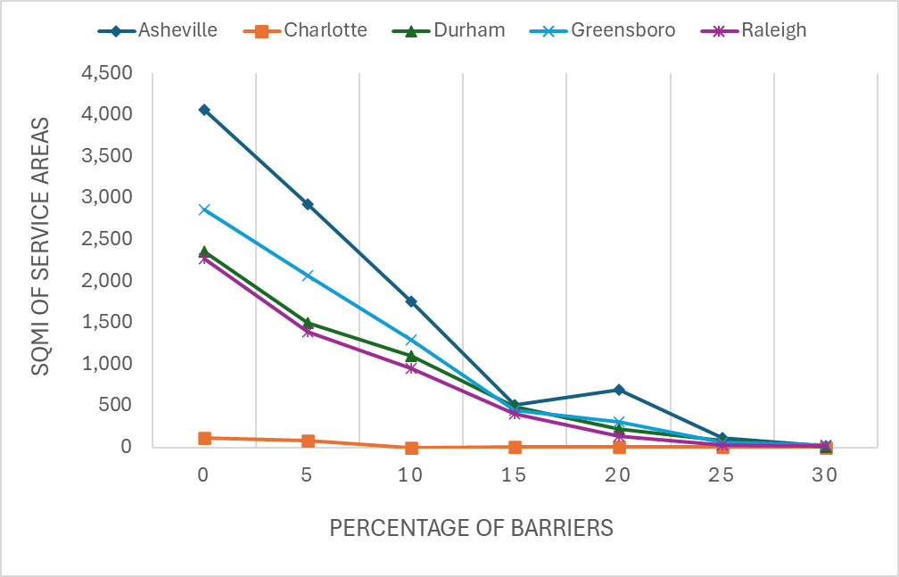
Effect of Random Barriers on Service Area Coverage at All Cutoff (5+10+15 min)
0-15% Barriers:
Asheville: -87%
Durham: -79%
Greensboro: -84%
Raleigh: -82%
-28%
-27%
-40%
-37%
-71%
-36%

Slide 19
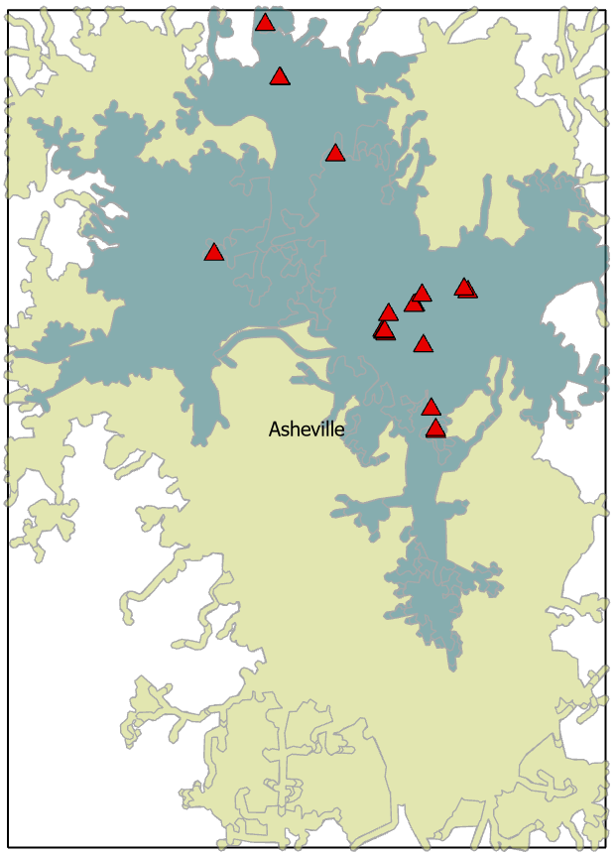
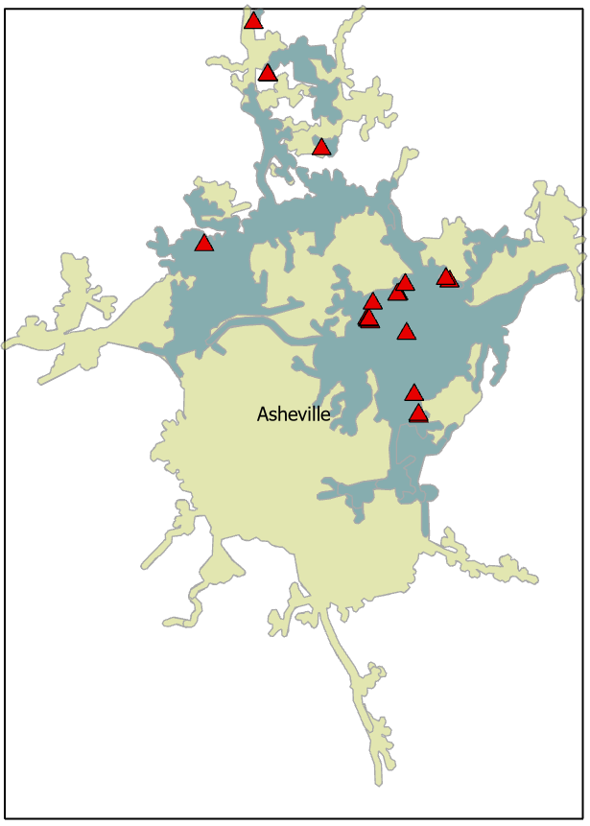
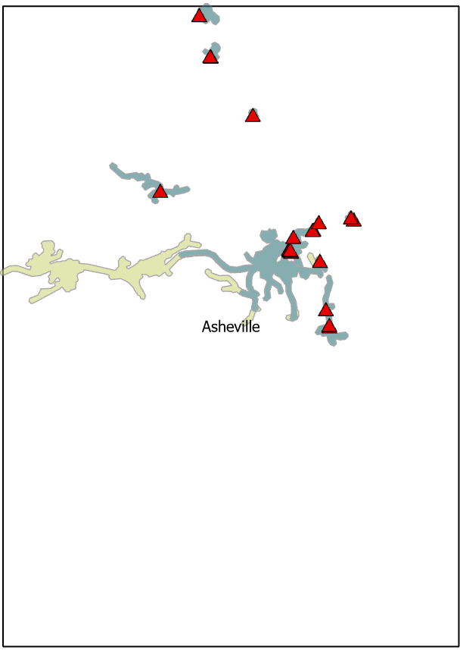

Asheville
Service Area Coverage without road barriers (map scale 1:220,000)
Asheville
Service Area Coverage with 15% road barriers (map scale 1:220,000)
Asheville
Service Area Coverage with 30% road barriers (map scale 1:220,000)

Slide 20
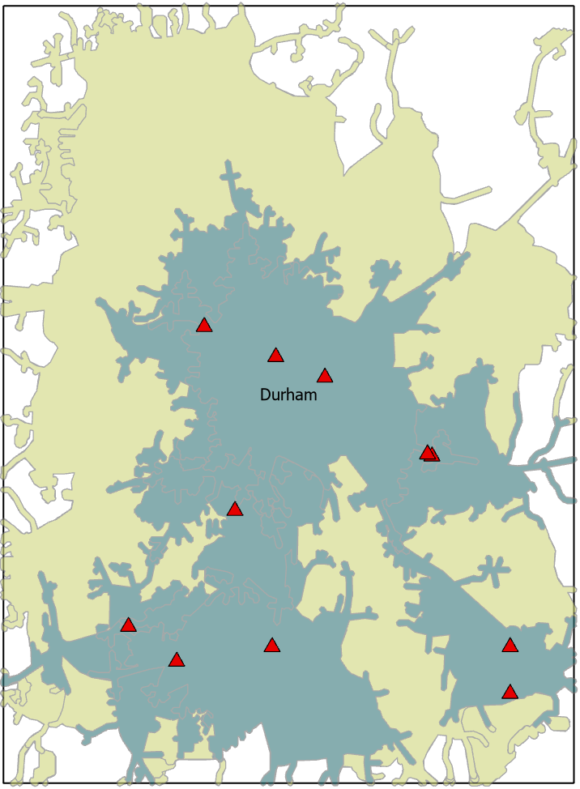
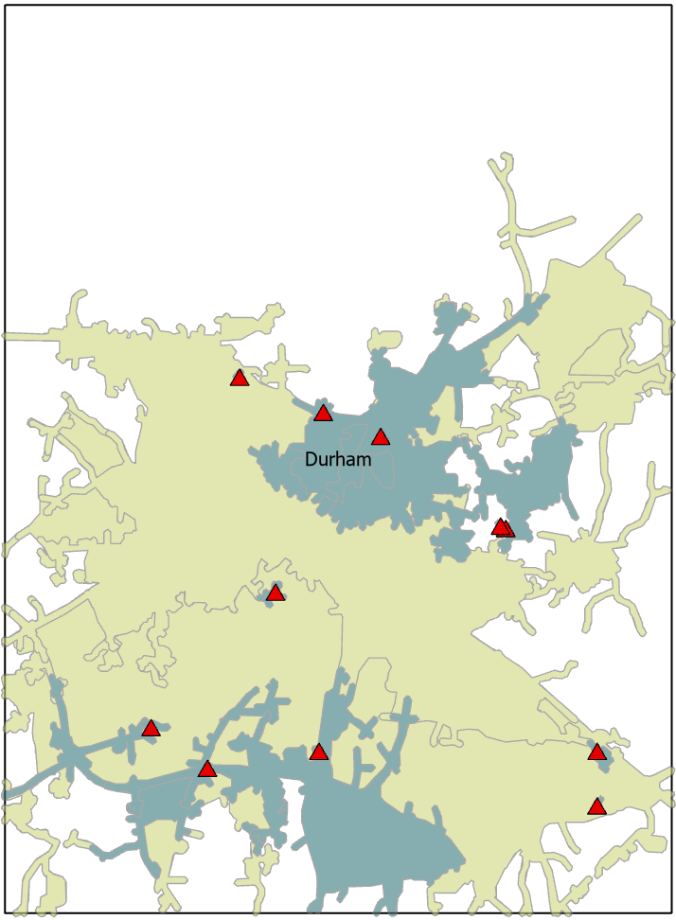
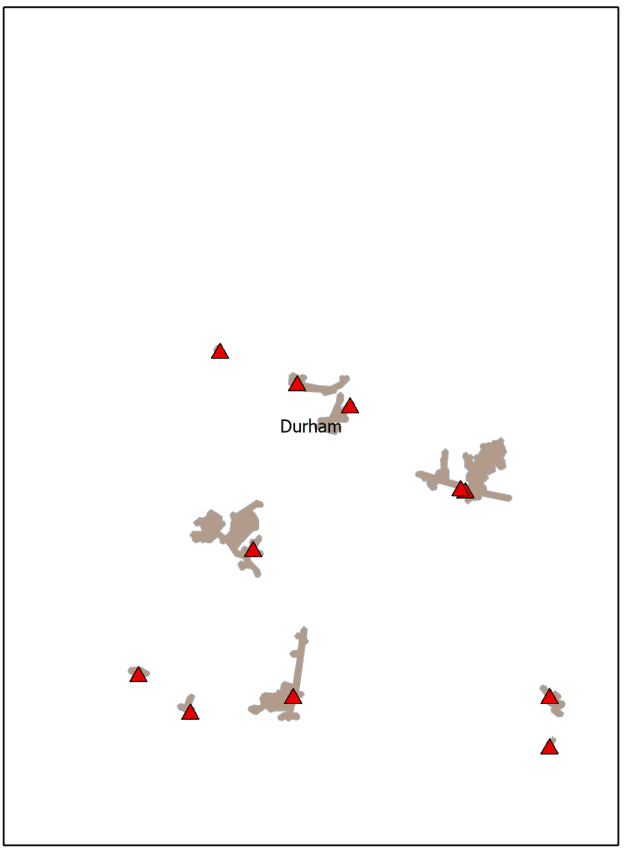
Durham
Service Area Coverage without road barriers (map scale 1:220,000)
Durham Service Area Coverage with 15% road barriers (map scale 1:220,000)
Durham
Service Area Coverage with 30% road barriers (map scale 1:220,000)

Slide 21
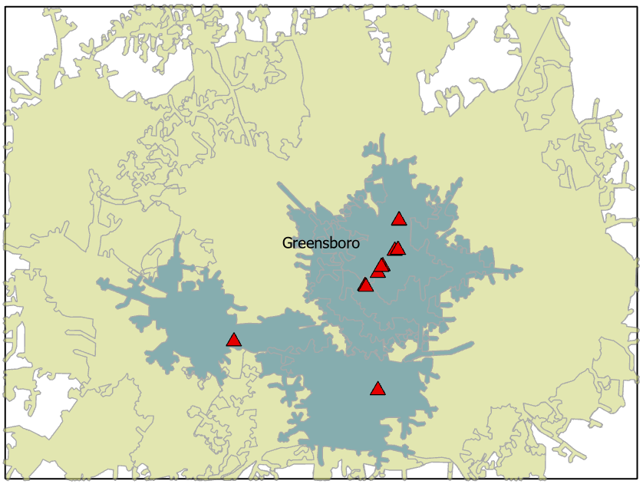
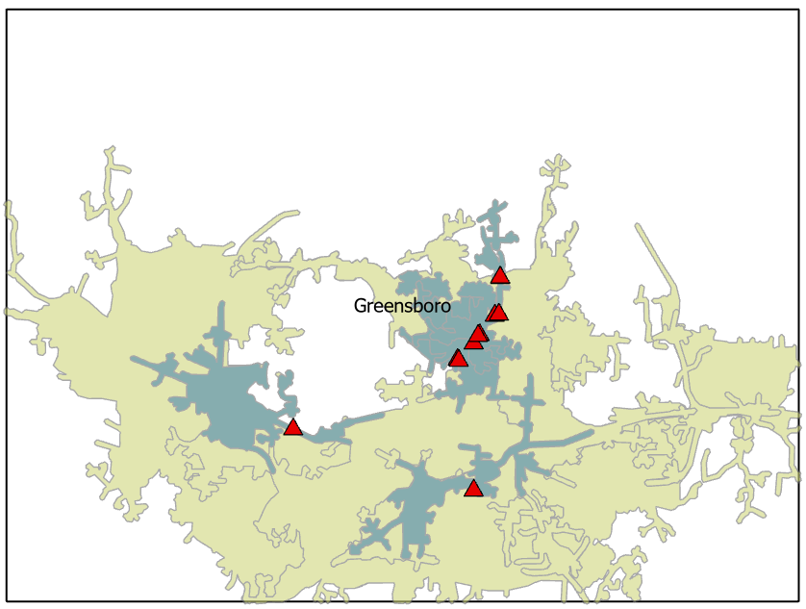
Greensboro
Service Area Coverage without road barriers (map scale 1:220,000)
Greensboro
Service Area Coverage with 15% road barriers (map scale 1:220,000)

Slide 22
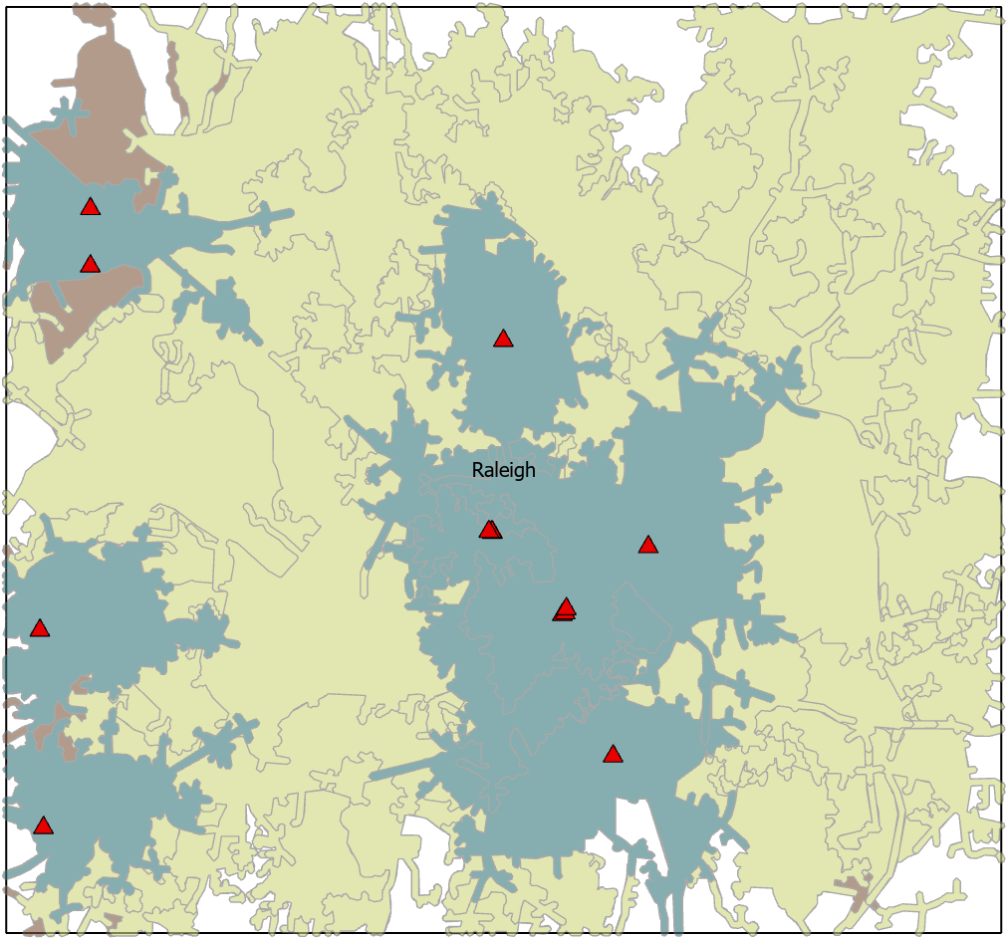
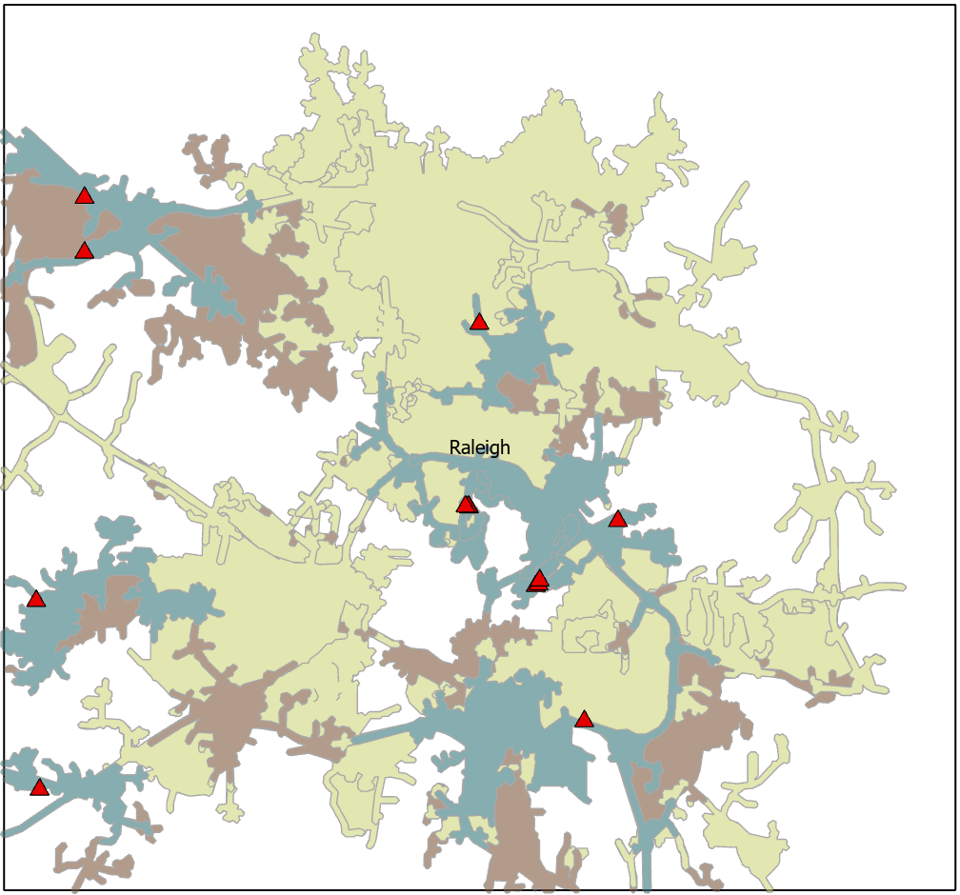
Raleigh
Service Area Coverage without road barriers (map scale 1:220,000)
Raleigh
Service Area Coverage with 15% road barriers (map scale 1:220,000)

Slide 23
Conclusions
All networks of the five cities are vulnerable to random events, with various degrees, causing critical decline in service area coverage of essential services.
Asheville, despite starting with the largest service area, experiences extreme losses, emphasizing its dependency on an uninterrupted network.
Vulnerability of all networks is potentially the same when 15% of edges are randomly disrupted.
  Durham, Greensboro, Raleigh maintain some resilience but still lose over 75% of their service areas by 15% barriers.
These findings suggest the need for redundancy in transportation planning to maintain access to essential services during disruptions.
The geographic distribution of essential services have potential effect on the vulnerability of the network: more dispersal (Durham, Raleigh case), less vulnerable.

Slide 24
Thank you !!
Trung V. Tran, PhD, GISP | ttran1@uncfsu.edu

